Slide 1
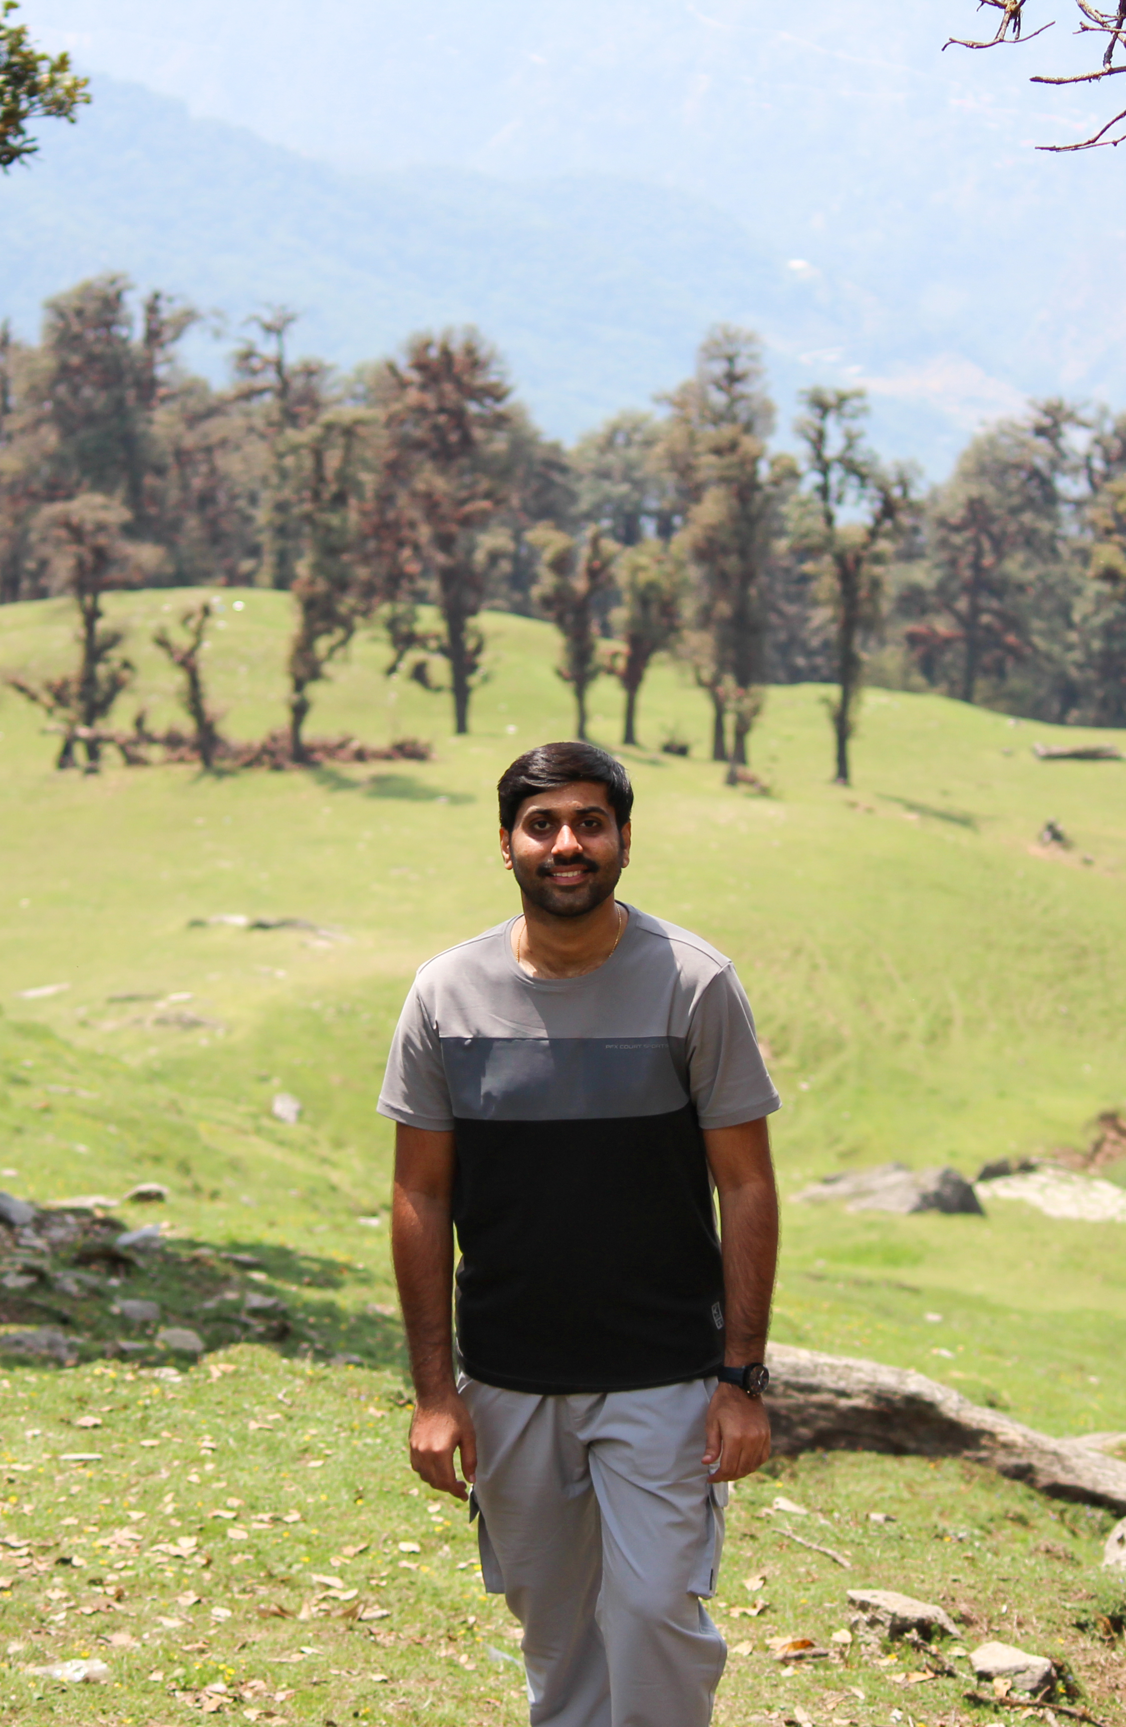
About Me
Name: Sannihith Reddy
Hometown:
Nellore, Andhra Pradesh
Education:
M.Tech in Embedded Systems, Amrita University, Coimbatore.
Current Role:
Software Engineer, Siemens Healthineers
Previous Experience:
Software Engineer, Philips
Intern, Philips
Major Skills: C#, .Net, Unit testing, Python, Git, Agile
Achievements:
Recipient of the PIC Annual Award for Patient Safety, Quality, and Integrity (H2'22).
Recognized as a Software Role Model for driving Philips' transformation in 2022.
Publications:
Published a springer conference paper on Estimation of State of Charge Using EKF and SVR in Li-Ion Battery. [November 2022]
Published an IEEE conference paper on Load Optimization and Forecasting for Microgrids. [March 2019]
Hobbies:
Photography
Badminton

Slide 2
My Key Achievements
Achievement 1: PIC Annual Awards H2'22 Winner in the Patient Safety, Quality & Integrity Always category
Awarded For: Successfully addressing a hardware issue at the software level, ensuring uninterrupted scan workflows on the CT7500 scanner.
Brief Description:
The CT Scanner application interacts with a third-party injector device via a LAN cable to perform specialized scans. At a customer site, the application was repeatedly crashing during injector scans, which posed a risk to patient safety. If the application crashed after the patient received a contrast fluid injection, the scan would need to be repeated, which could delay treatment and affect patient outcomes. Additionally, network interference often caused application failures, leading to unreliable scan results.
My Role & Contributions:
I was tasked with making the application resilient to network interference and ensuring smooth injector scans even during network disruptions.
Diagnosis:
The issue was complex due to the legacy nature of the feature (developed over 20 years ago), with limited documentation available. I first familiarized myself with the feature's behavior in a stable network environment and then used a network interference simulation tool (KMAX) to replicate and analyze the problem.

Slide 3
My Key Achievements
Root Cause Analysis:
The application communicated with the injector device on the UI thread, causing the UI to freeze when the injector responded slowly due to network interference. This freeze led to application crashes if the user interacted with the unresponsive UI.
The application frequently communicated with the injector for various tasks (e.g., checking if the application was running, fetching patient details, configuring scan parameters), exacerbating the problem.
Solution Implementation:
Redesign: I moved the injector communication to a background thread to prevent UI freezing. However, conventional threading was inadequate due to the old technology stack (WinForms) and tightly coupled design.
User Experience: To address this, I implemented an auto-closing pop-up message that notified users that data was being processed. This pop-up closed automatically when data was received or if the injector failed to respond, allowing the application to proceed with default data.
Synchronization: This pop-up mechanism also synchronized multiple injector communications from background threads, ensuring a smoother user experience.
Outcome & Learnings:
Outcome: This solution resolved the crashing issue and improved the reliability of the injector scans, significantly enhancing customer satisfaction and patient safety.
Learnings: I gained valuable experience in handling legacy systems, designing resilient applications under constraints, and improving user experience despite technological limitations.

Slide 4
My Key Achievements
Achievement 2: Software Role Model for the significant contributions made towards Philips' transformational journey throughout 2022.
Awarded For: Reducing product build time by 50% through the implementation of Smart Test Ordering (STO)
Brief Description:
At my previous organization, the CT scanner application contained over 1,20,000 test cases, causing build times to exceed 1.5 hours. Frequent build failures occurred due to test cases getting stuck or failing because of resource constraints.
My Role & Contributions:
I took the initiative, with support from the architecture team, to address this challenge by designing and implementing a tool to reduce the overall build time.
Challenges:
Existing Problem: The build pipeline frequently failed, and the extensive number of test cases contributed to long build times. Existing pipeline tools were inadequate due to the legacy nature of the code and the need for test cases to run in a specific order.
Legacy Code Dependencies: The legacy nature of the code required handling dependencies between test cases that traditional tools did not support.
Tool Development: Existing tools from Azure DevOps could not accommodate the need for a fixed test execution order due to the complex dependencies.

Slide 5
My Key Achievements
Solution:
I developed a custom tool called Smart Test Ordering (STO) to address these issues. STO uses Azure APIs to:
Fetch a list of modified files from a given pull request (PR).
Determine which test cases need to be executed based on these modifications, rather than running the entire test suite.
Outcome & Learnings:
Outcome: The implementation of STO reduced build times by 50%, improved the efficiency of the development pipeline, and decreased the frequency of build failures.
Learnings: This helped me in learning few basic things about DevOps and how pipelines are created and how code gets executed in pipeline.

Slide 6
Video Library Manager
Case Study
Design and implement a desktop application to view and manage videos :
Displays relevant information related to Files
Supporting Operations to view, upload/download, versioning etc.
Features
Based on the inputs provided and few assumptions I made. I have understood that I need to develop a video library manager application that provides below features.
1. Video Management:
Lists all available cloud and local videos, grouped by folders.
Refresh button to reload the video library.
Search bar to filter local videos.
Displays metadata (full path, duration, file size, date modified) on hover for each local video.
Playback Controls:
Play (on double-click), pause, stop, and resume functionality.
Seek bar for navigating through the video and displaying the video duration.
Slider to adjust the volume level.
Play video in full screen.

Slide 7
Video Library Manager
Features(cont.)
Context Menu Options (Right-Click on Local Videos):
Rename video.
Delete video.
Upload video files to the cloud.
Context Menu Options (Right-Click on Cloud Videos):
Upload new version.
Download video.
Download previous version of video.
Delete video.
Cloud Operations:
Upload video files to the cloud.
Upload a new version of an existing video to the cloud (this updates the video on the cloud and saves the current version for future retrieval).
Download video files from the cloud.
Download previous version of a selected video file from the cloud.
Delete video files on the cloud (by default, this deletes the associated previous version as well).
User Notifications:
Status bar to display notification messages to the user.
Pop-up messages to notify the user about upload, download, and delete statuses.

Slide 8
Tech Stack
Dotnet 8.0
Jfrog Cloud Platform
Third party packages
CommunityToolkit.Mvvm,
Microsoft.Extensions.Configuration,
Microsoft.Extensions.Logging,
NAudio
Steps to launch the application
Clone this repository.
Create a JFrog Cloud Platform instance to back up the video files [https://jfrog.com/start/].
Launch the created instance, create an artifact, and obtain the artifact key and artifact URL.
Create an environment variable named JFROG_API_KEY and place the artifact URL in the appsettings.json file located in the repository's root directory.
Build the code and launch the application.
Configuration
Modify "ArtifactoryUrl" in appsettings.json file with the artifact URL created before.
Modify the “RootPaths” section in the appsettings.json file to set the directories from which videos need to be displayed in the application.
Modify the “VideoExtensions” section in the appsettings.json file to specify the types of videos to be searched for.

Slide 9
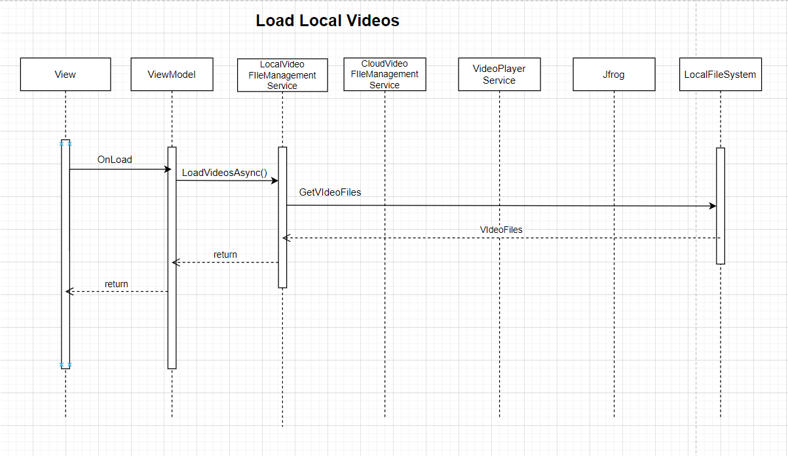
Design
Code Walk through to explain design patterns used

Slide 10
Sample use cases
On launch: The application displays a list of all video files available from the configured RootPaths.
Note: Video files from local and cloud sources are displayed separately.
Play a video: Double-click on any video file listed under the local video files section to play the video.
Control playback: Use the UI buttons to control playback options, including Play, Pause, Stop, Full Screen, and dragging the seek bar to forward.
Manage local video files: Right-click on videos in the local video files section to rename, delete, and upload the file to the cloud.
Manage cloud video files: Right-click on videos in the cloud video files section to download, delete, upload a new version, and download a previous version.
On clicking the upload new version option, the current version of the video file is updated with the new video selected by the user.
The old version of the video can be retrieved using the download old version option.
Note: Deleting a video on the cloud will also delete the associated old versions.

Slide 11
Future Scope
Features:
Shortcut Keys to play, forward etc.,
Directly launch the application from file explorer to play the video
Thumbnail
Progress bar
Enhance versioning
Stream video from cloud
Sorting videos
Easy installation and updates
Design:
Make multiple views
Make features more user friendly
Refactor further to improve performance and maintainability of application

Slide 12
Thank You

